Slide 1
CHAPTER 3
Customer Expectations of Service

Slide 2
Chapter Objectives
Recognize that customers hold different types of expectations for service performance.
Discuss several sources of customer expectations of service.
Acknowledge that the types and sources of expectations are similar for end consumers and business customers, for pure service and product-related service, for experienced customers and inexperienced customers.
Delineate some important issues surrounding customer expectations.

Slide 3
Customer expectations are beliefs about service delivery that serve as standards or reference points against which performance is judged.
What are some expectations that customers hold about service?

Slide 4

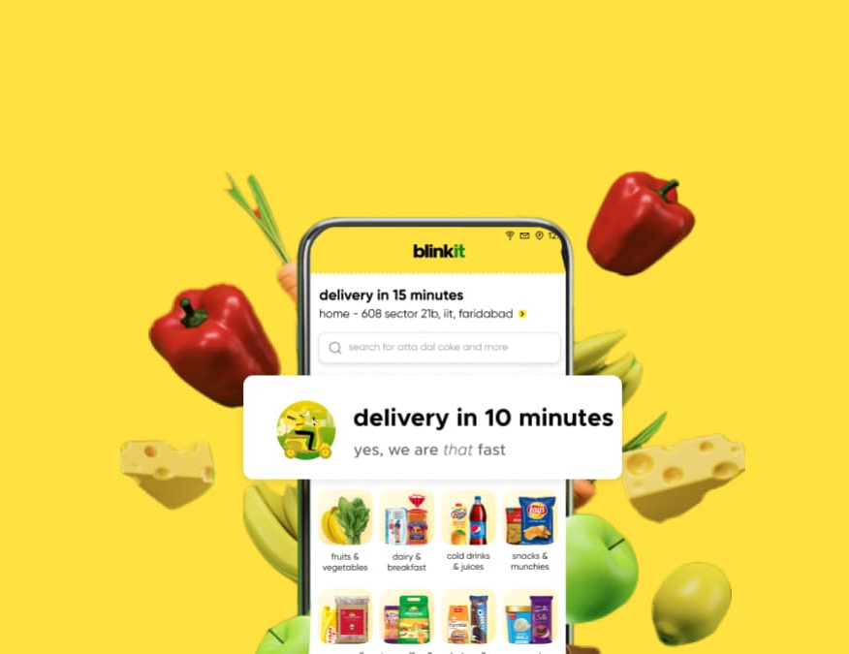
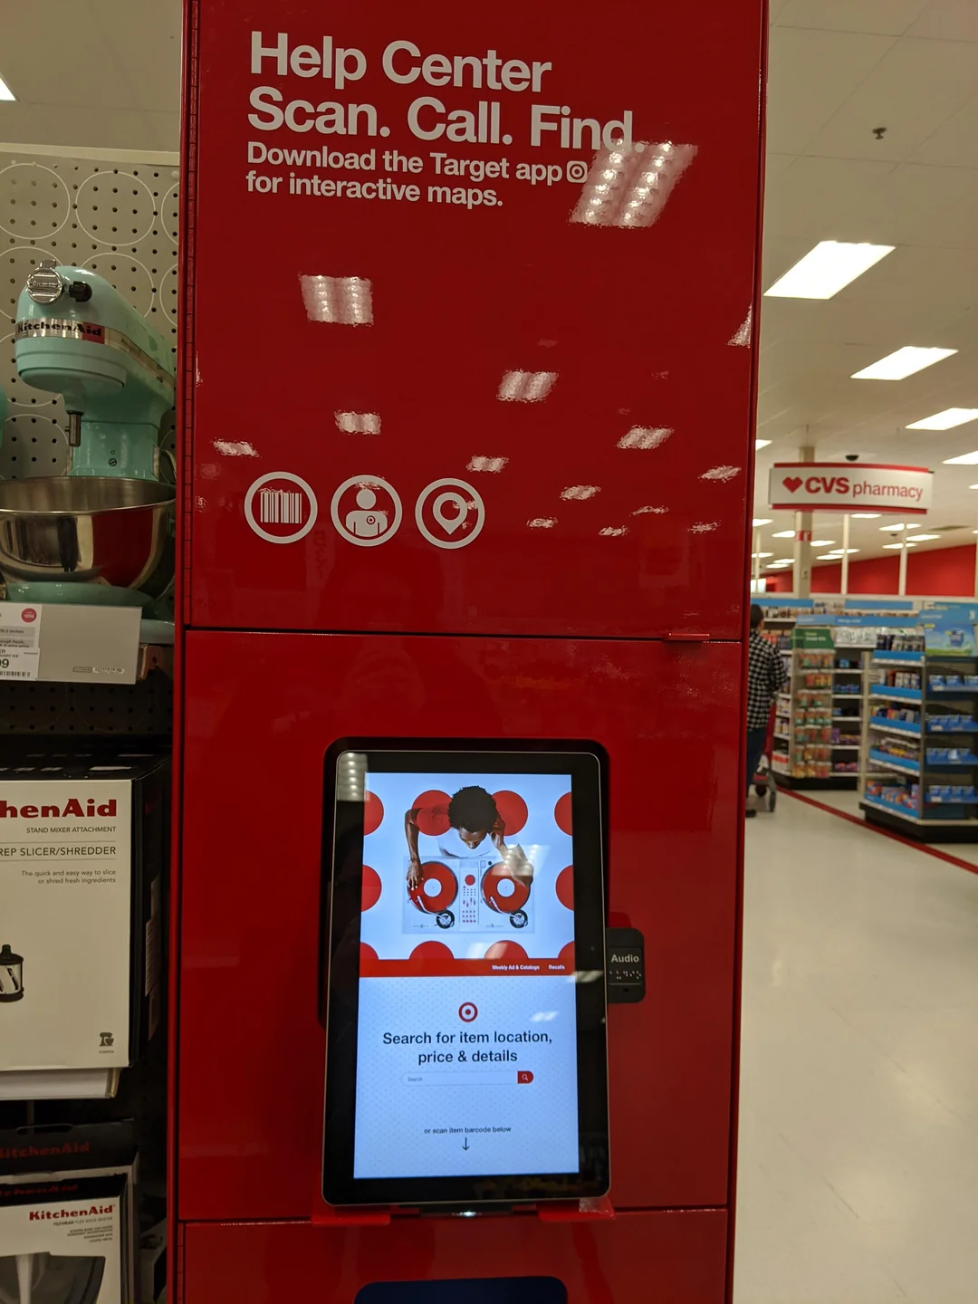
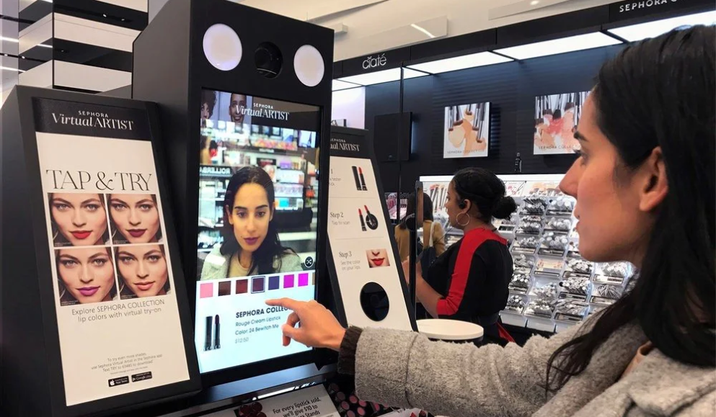
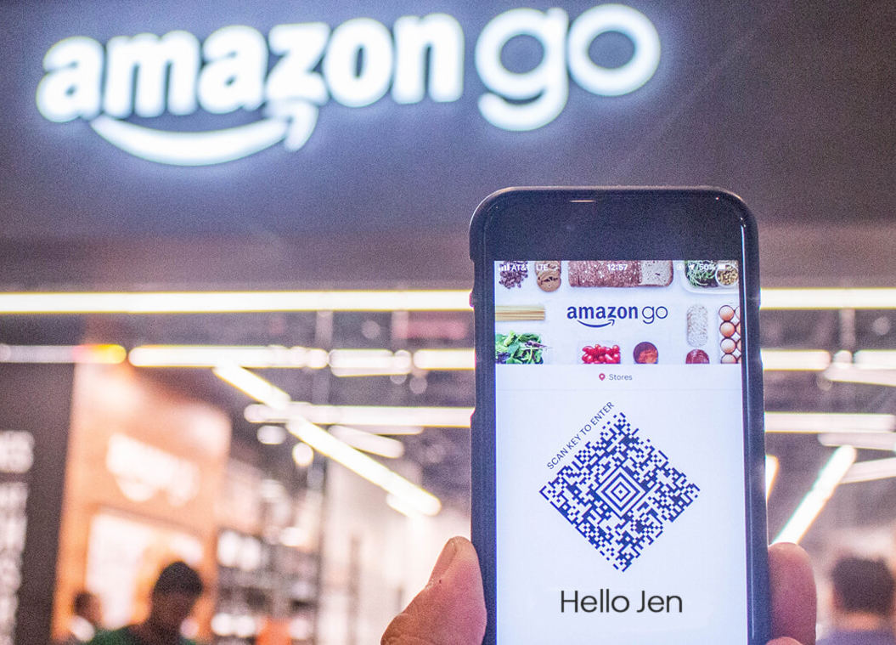
Technological Evolution and Shifting Expectations
Notes:
Rapid technological advancements lead to shifting customer perceptions of cutting-edge products and services. Examples like faster delivery becoming the norm and the desire for shareable experiences highlight how innovation shapes customer expectations.

Slide 5
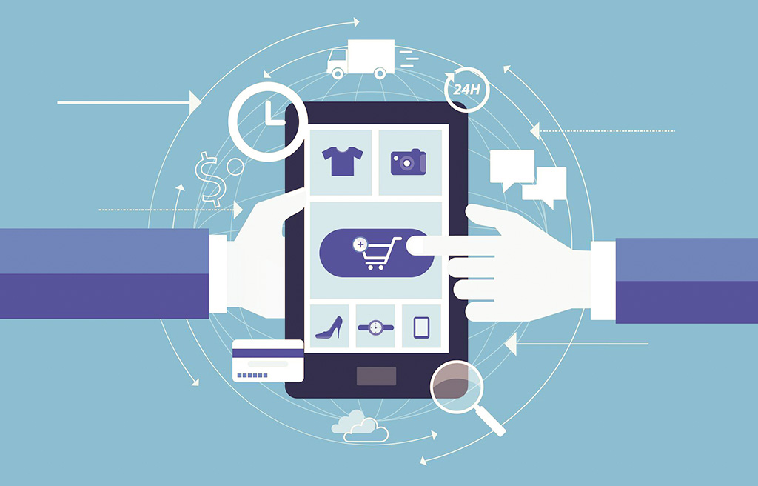
Competitive Landscape and Inter-Industry Influence
New standards can transfer from one company to the next through customer expectations.
The “Amazon Effect” signifies the rise in customer expectations influenced by Amazon’s streamlined business approach.
As customer expectations change (as a result of technology), managers have to keep up.
There is only one direction that customer expectations go: UP!
Notes:
Disruptive technologies drive highly personalized and convenient experiences, setting high standards for service across industries. Customer expectations influenced by one industry extend to others, necessitating managers to monitor evolving benchmarks and adapt to rising demands.
Amazon has set new standards for convenience, fast delivery, pricing accuracy, and customer-centric service, shaping how customers expect to interact with companies. This effect extends beyond online retail, impacting industries like coffee ordering. As customer expectations continually rise, managers must take notice, as research shows that customers are more willing to switch providers if expectations aren't met. Amazon's focus on surpassing customer expectations reflects its success in retaining loyalty and highlights the ongoing trend of elevating customer demands.

Slide 6
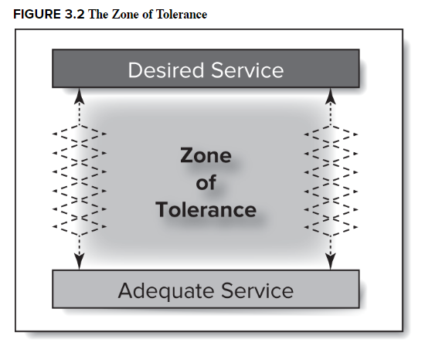
2 Types of Customer Expectations
Desired Service: highest expectations
Adequate service: minimum tolerable expectation
Notes:
Level of expectation can vary depending on the reference point the customer holds. Customers assess service performance on the basis of two boundaries: what they desire and what they deem acceptable. These two expectation levels can vary.

Slide 7

Desired Service
Desired service is a blend of what the customer believes “can be” and “should be” provided.
For example, while applying for jobs online, all the criteria (e.g., location, role, salary etc.) need to be matched. This expectation reflects the hopes and wishes of these consumers.

Slide 8

Adequate Service
The threshold level of acceptable service, which is the minimum level of service the customer will accept.
Example: the job you are willing to take (sometimes while waiting for the dream job)

Slide 9
The Zone of Tolerance
The extent to which consumers are willing to accept variation in services.
In this range, consumers do not particularly notice service performance.
If performance falls outside the range, it gets customer’s attention in either a positive or negative way.
It expands and contracts based on customers, conditions (e.g., price) and service dimensions.
Notes:
Different customers possess different zones of tolerance
When prices increase, customers tend to be less tolerant of poor service. In this case, the zone of tolerance narrows because the adequate service level shifts upward.
In general, desired service is relatively stable compared to adequate service.

Slide 10
Do we live in a zone of tolerance?

Slide 11
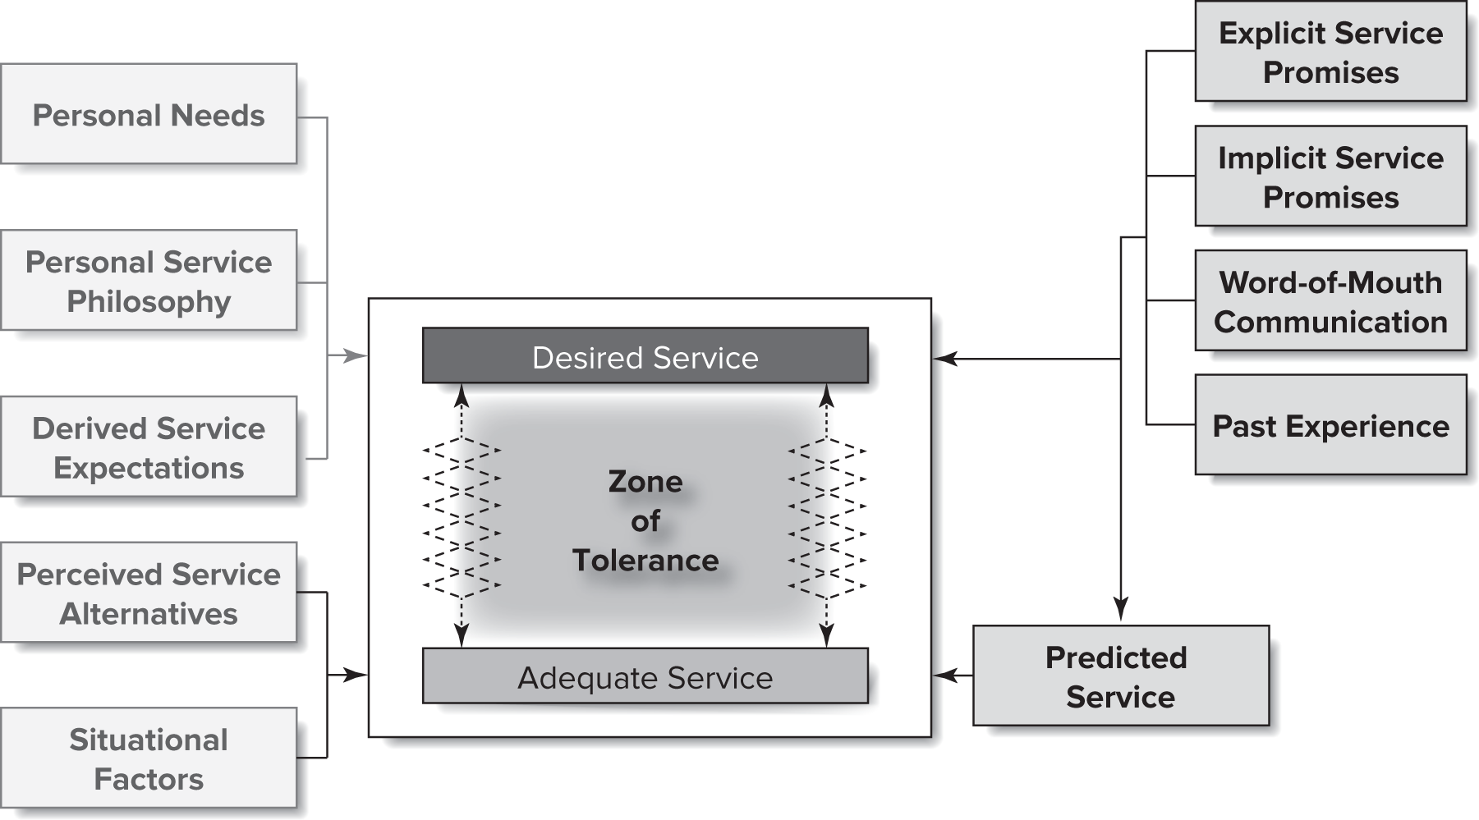
Sources of All Service Expectations

Slide 12
Sources of Desired Service
Personal needs: states or conditions essential to the physical or psychological well-being of the customer.
  Ex: Think about personal characteristics - high social needs might expect / desire a hotel to have a thriving bar.
Personal service philosophy: underlying generic attitude about the meaning of service and the proper conduct of service providers.
  Ex: This is your basic expectation - how long you believe you should wait before you are served at a restaurant.
Derived service expectations: when customer expectations are driven by another person or group of people.
  Ex: This is about meeting someone else’s desires - a parent choosing a vacation for the family will build pressure on the parent to meet the family’s expectations.
Notes:
Personal needs may include physical, social, psychological, functional needs.
For B2B transactions, customer expectations may be driven by the expectations of their own customers.

Slide 13
Sources of Adequate Service
Perceived service alternatives: other providers who customers can – or believe they can – obtain the service.
  If you believe you can do it yourself then you might hold others to a higher expectation (e.g., cutting the lawn, making dinner, etc.).
  When sources are limited, the zone of tolerance may increase.
Situational factors:
  Uncontrollable: conditions beyond the control of the service provider, e.g., flight delays due to bad weather – may widen the zone of tolerance.
  Personal: short-term, individual factors that make a customer more aware of the need for service (such as emergencies) – the zone of tolerance may be narrowed.
Predicted service: the level of service that customer anticipate they will get (amplified by prior experiences).
  Ex: certain services may be slower in college towns during first few weeks of school due to higher demand.
Notes:
These influences are short-term and tend to fluctuate more than the factors that influence desired service.
Service marketers need to be aware of the complete set of options that the customers view as perceived alternatives.
When a problem occurs for the first time, expectations are heightened, and customers expect higher level of adequate service.
If customers predict good service, their levels of adequate service are likely to be higher than if they predict poor service.

Slide 14
Sources of Both Desired & Predicted Service
Explicit promises: personal and non-personal statements about the service made by the company to customers.
  Distributed through marketing communications, delivered by company representatives.
Implicit promises: service-related cues that lead to inferences about what the service should and will be like (like higher prices might mean better quality).
Word-of-mouth communication: statements made by parties other than the organization
  Carries more weight as is often considered unbiased.
  Helps customers when services are difficult to evaluate before purchase (e.g., Google Reviews)
Past experience: most of us draw from this!
Notes:
Explicit promises are completely within the control of the service provider.

Slide 15
What does a service marketer or manager do if customer expectations are unrealistic?
Give me some examples.
Notes:
In general customers want fundamentals to work (e.g., planes to take off on time, hotel rooms to be clean)
Ask customers what they want – heightens the belief that the company will do something with the information that surfaces.
If not able to provide what the customers ask for, tell them why and describe plans for future efforts.

Slide 16
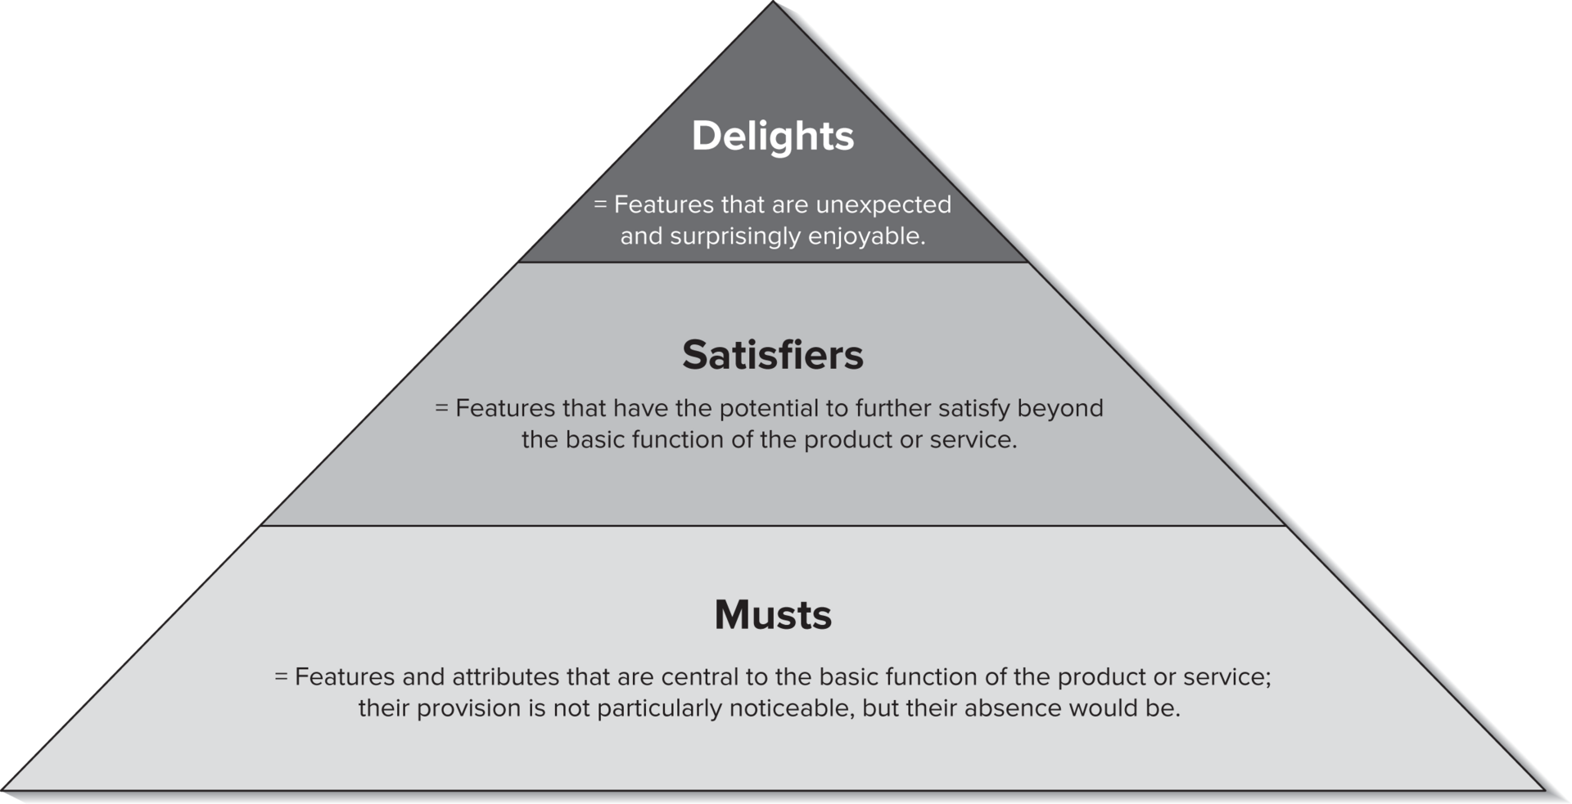
Musts, Satisfiers, and Delights

Slide 17
Customer Delight

Slide 18

Customer Delight
This occurs when service is unexpected, random, extraordinary, and disproportionately positive.
The basic premise of ‘customer delight’ is that firms should go above and beyond to delight their customers by exceeding expectations.

Slide 19
What is the issue with customer delight?
Notes:
In general customers want fundamentals to work (e.g., planes to take off on time, hotel rooms to be clean)
Ask customers what they want – heightens the belief that the company will do something with the information that surfaces.
If not able to provide what the customers ask for, tell them why and describe plans for future efforts.

